Slide 1
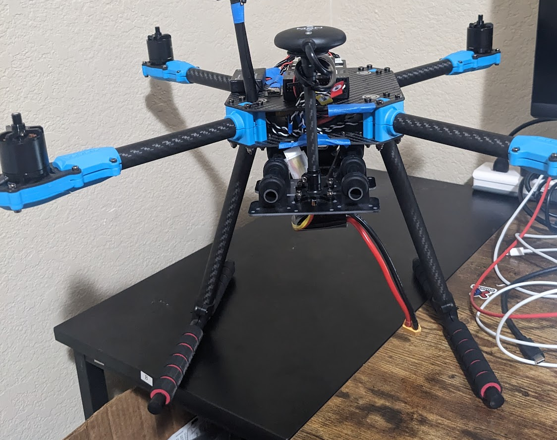
Project Title: Mirai3_0 Pose-Based Drone Control
Abhishek Chothani
November 01, 2023
Florida Institute of Technology

Slide 2
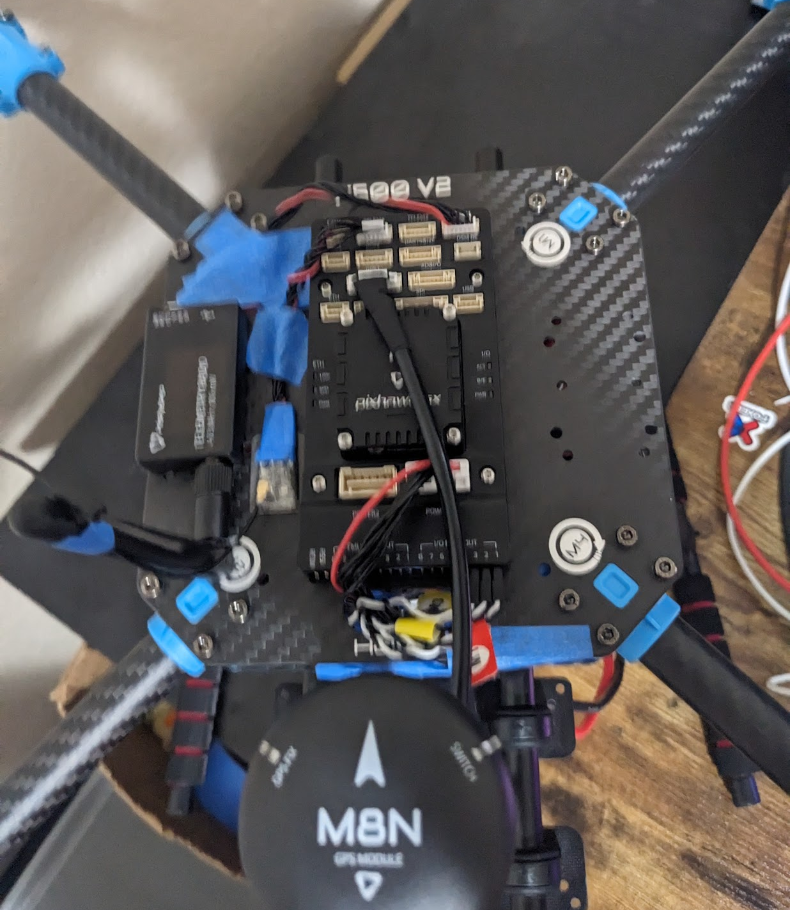
Introduction
Objective: The primary goal of the Mirai3_0 pose-based drone navigation project is to enable a drone to interpret human poses as flight commands, effectively creating a more natural and user-friendly interface for drone operation. The benefits of using pose estimation for this purpose include:
Fun: it’s more fun this way!
Accessibility: It opens up the possibility for users with limited mobility or those who are not familiar with traditional control systems to operate drones.
Real-time Interaction: This enables the drone to respond to real-time human gestures, making the interaction more dynamic and responsive.

Slide 3
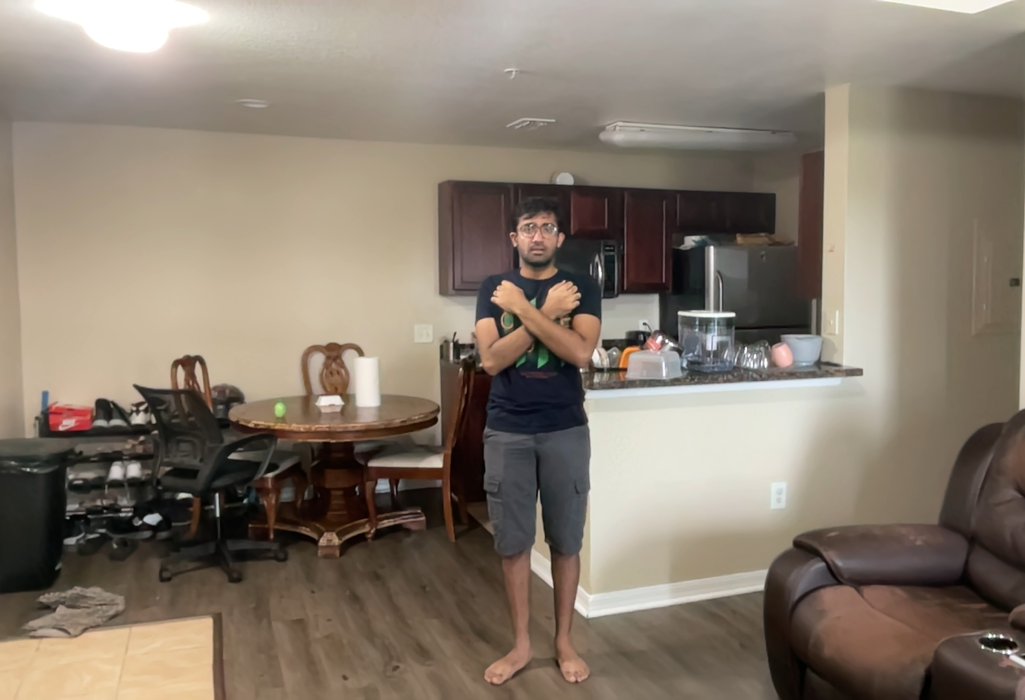
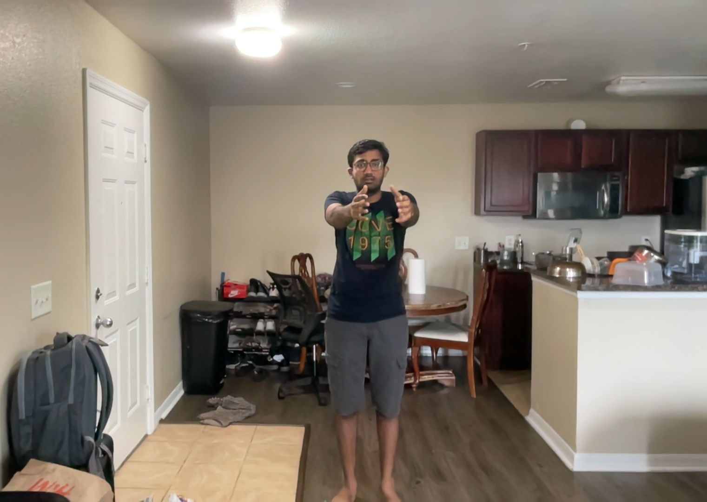
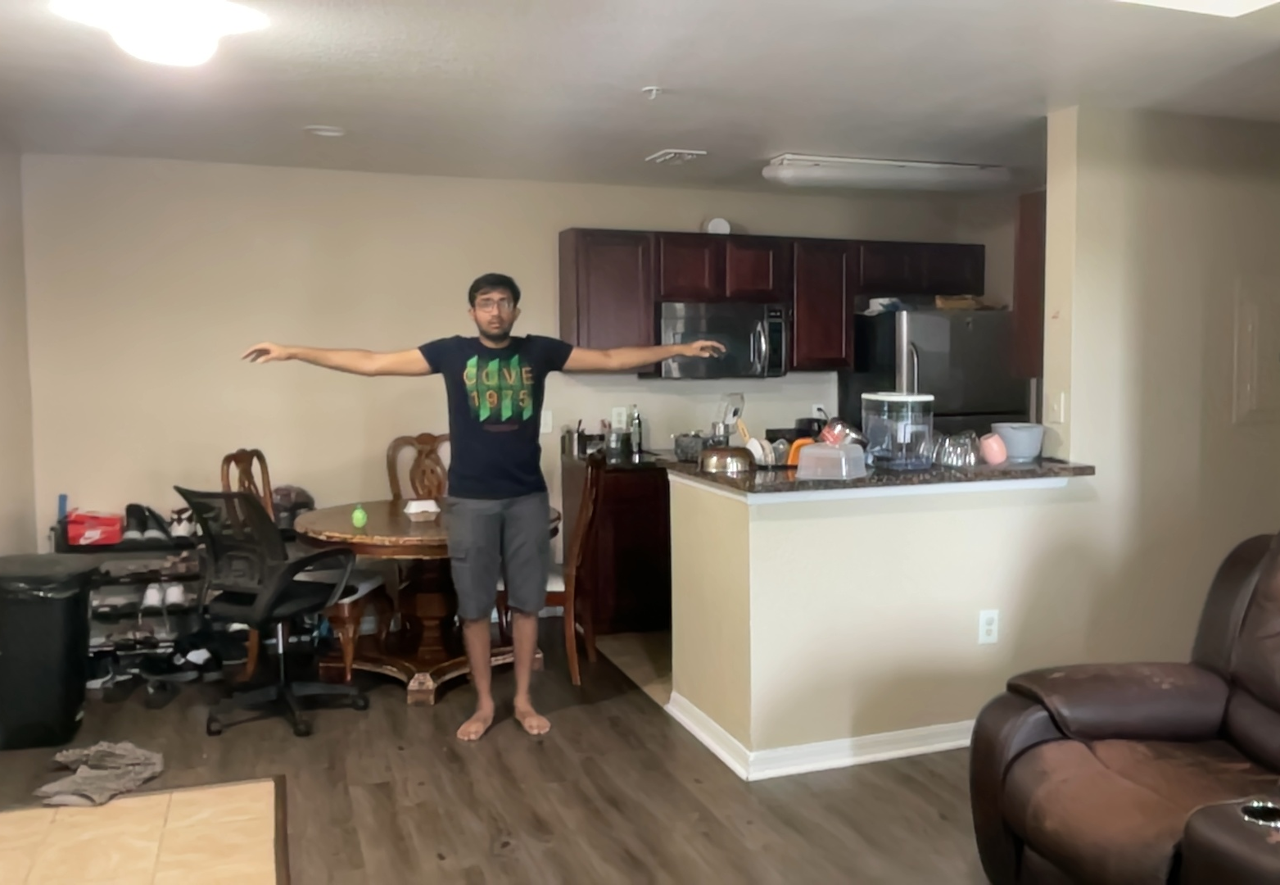
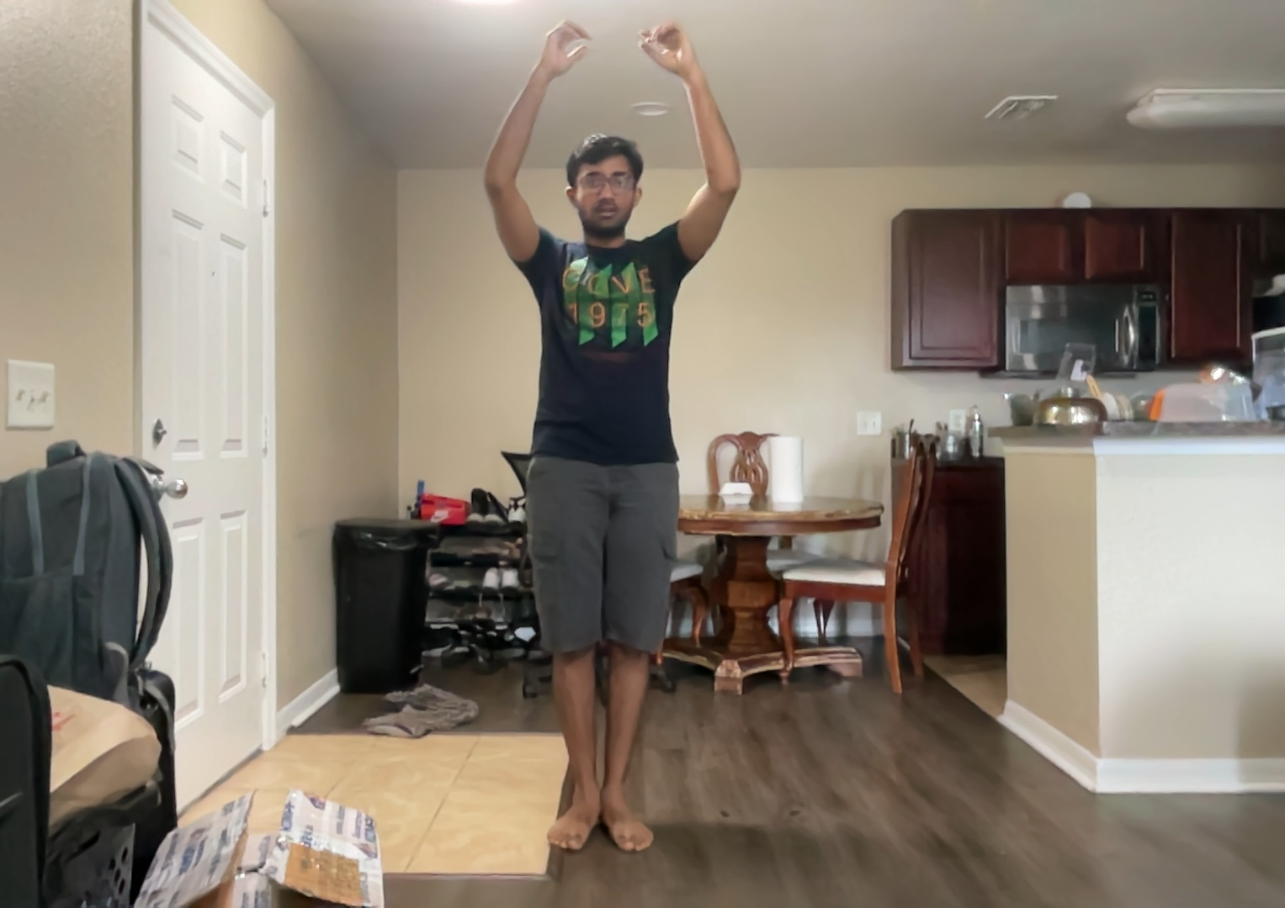
Dataset Overview
Description:
Total of 1600 images.
8 different poses: Takeoff, Land, Up, Forward, Backward, Right, Left, Do Nothing.

Slide 4
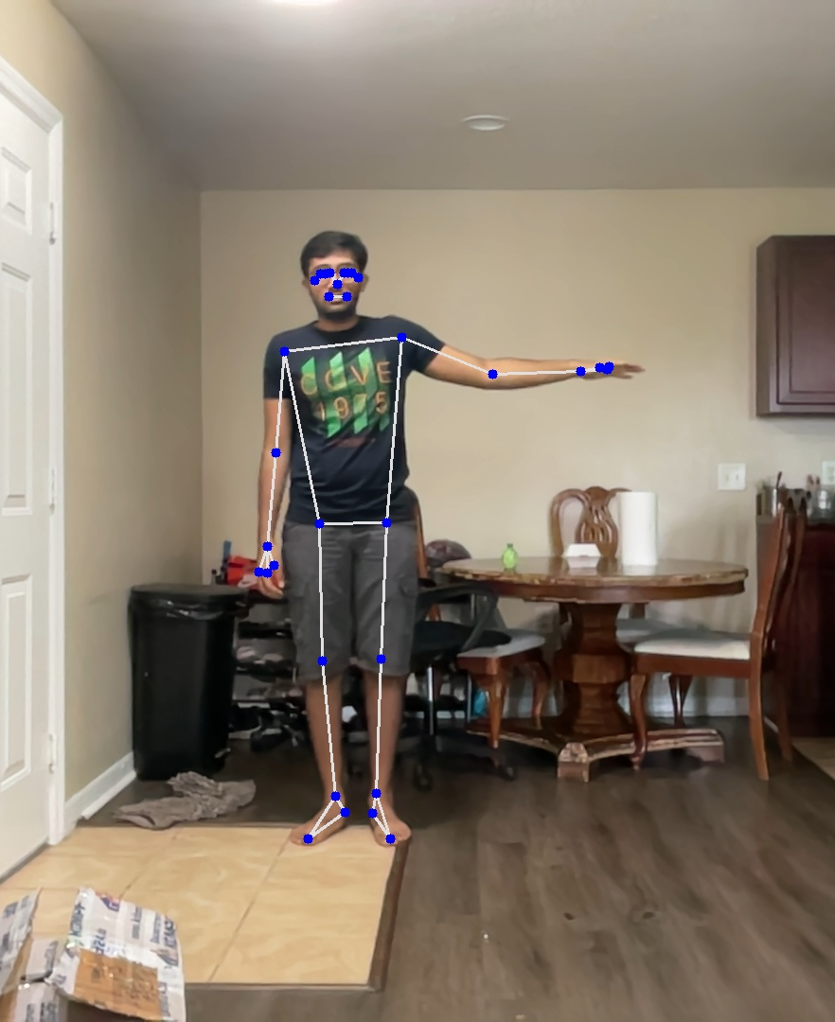
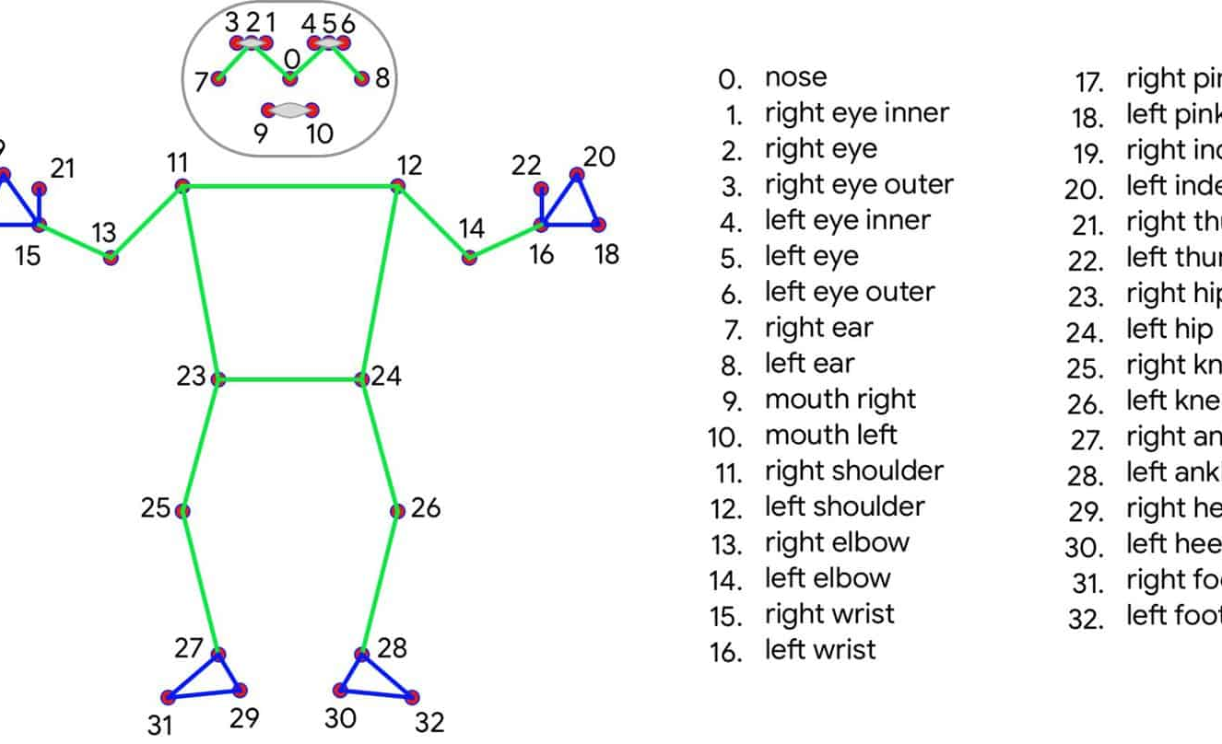
Pose Estimation with MediaPipe:
Process of converting images to 33 body point data.
Importance of this approach in reducing dimensionality and computational requirements.

Slide 5
Model Development
Model | Architecture | Training Time | Train Accuracy | Valid Accuracy
Benchmark | Fully Connected (no Hidden Layer) | 4.07s | 87.50% | 87.50%
Deep Fully Connected | 1 Hidden Layer | 4.43s | 87.50% | 87.50%
Expanded Dataset Model | Fully Connected (Increased data no Hidden Layer) | 75.41s | 94.69% | 94.61%
Deeper FC Model | Fully Connected (Increased data 1 Hidden Layer) | 146.76s | 99.80% | 99.84%
CNN | 1 Conv + 1 Pooling + 2 FC Layers | 141.15s | 99.78% | 99.77%

Slide 6
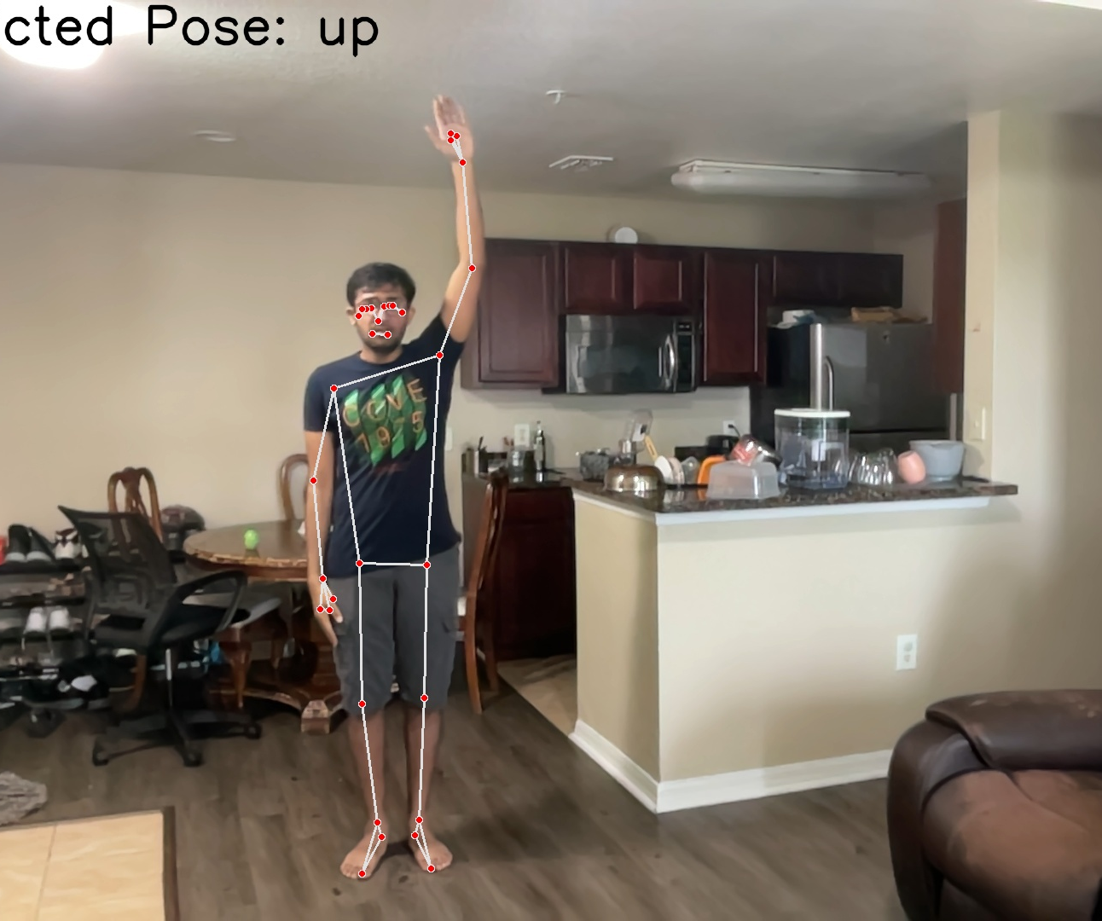
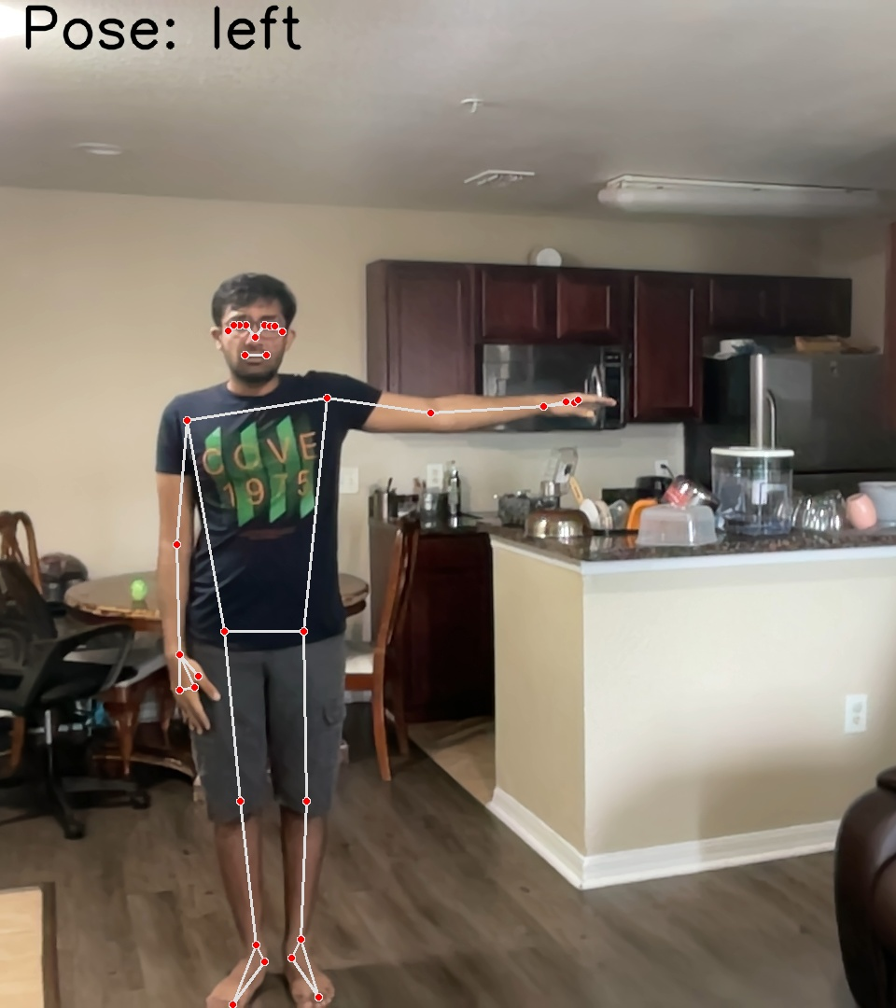
Predictions:

Slide 7
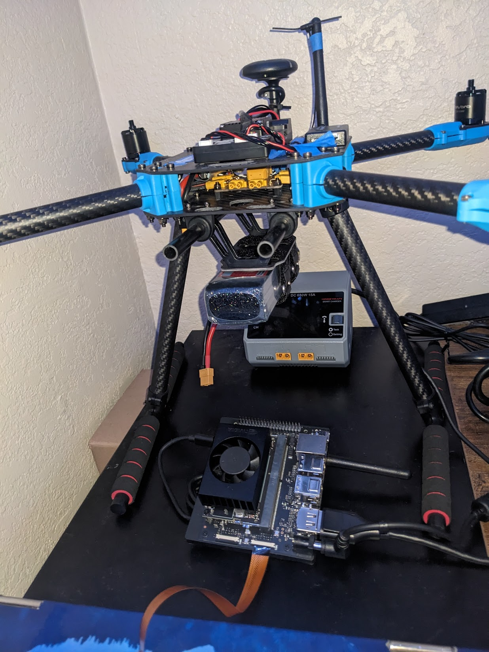
Drone Control System
Pose Classification: The classifier interprets a user's pose using the dataset and outputs a command corresponding to the pose.
Command Relay: This command is relayed to the PX4 Autopilot system via MAVSDK-Python, which acts as the communication bridge.
Flight Control: The PX4 Autopilot interprets the command and adjusts the drone's flight controls accordingly, executing maneuvers like takeoff, landing, or directional changes.
Feedback Loop: The drone's sensors provide real-time feedback to the PX4 Autopilot, ensuring stable flight and allowing for adjustments based on external conditions.

Slide 8

Future Work
Add more commands for the drone by creating new pose classes.
Use object detection and tracking so the drone can focus on specific people or objects before following pose commands.
Future Features:
Plan to gather more data through self-supervised learning. For example, the drone will detect an object, fly to it, and circle around to collect varied data. This method will help the drone learn better and become more autonomous.

